Slide 1
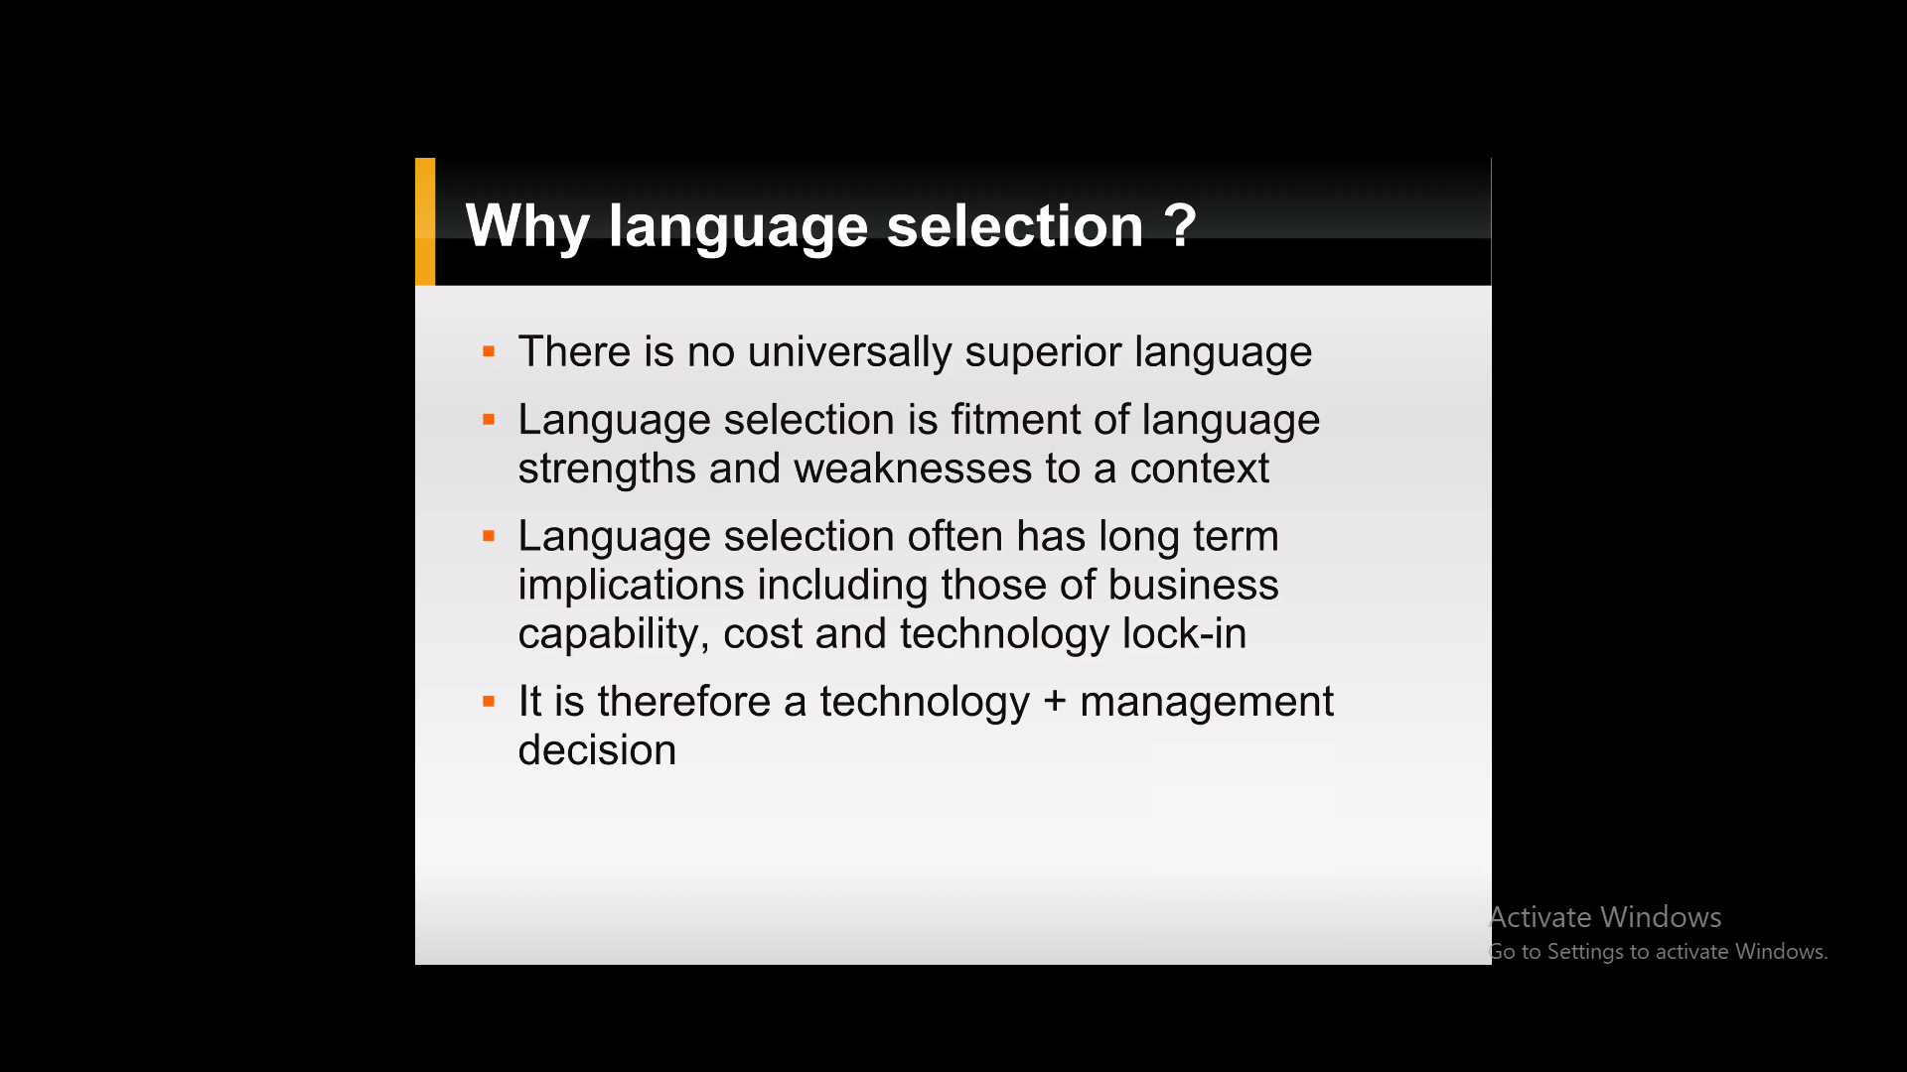

Slide 2


Slide 3
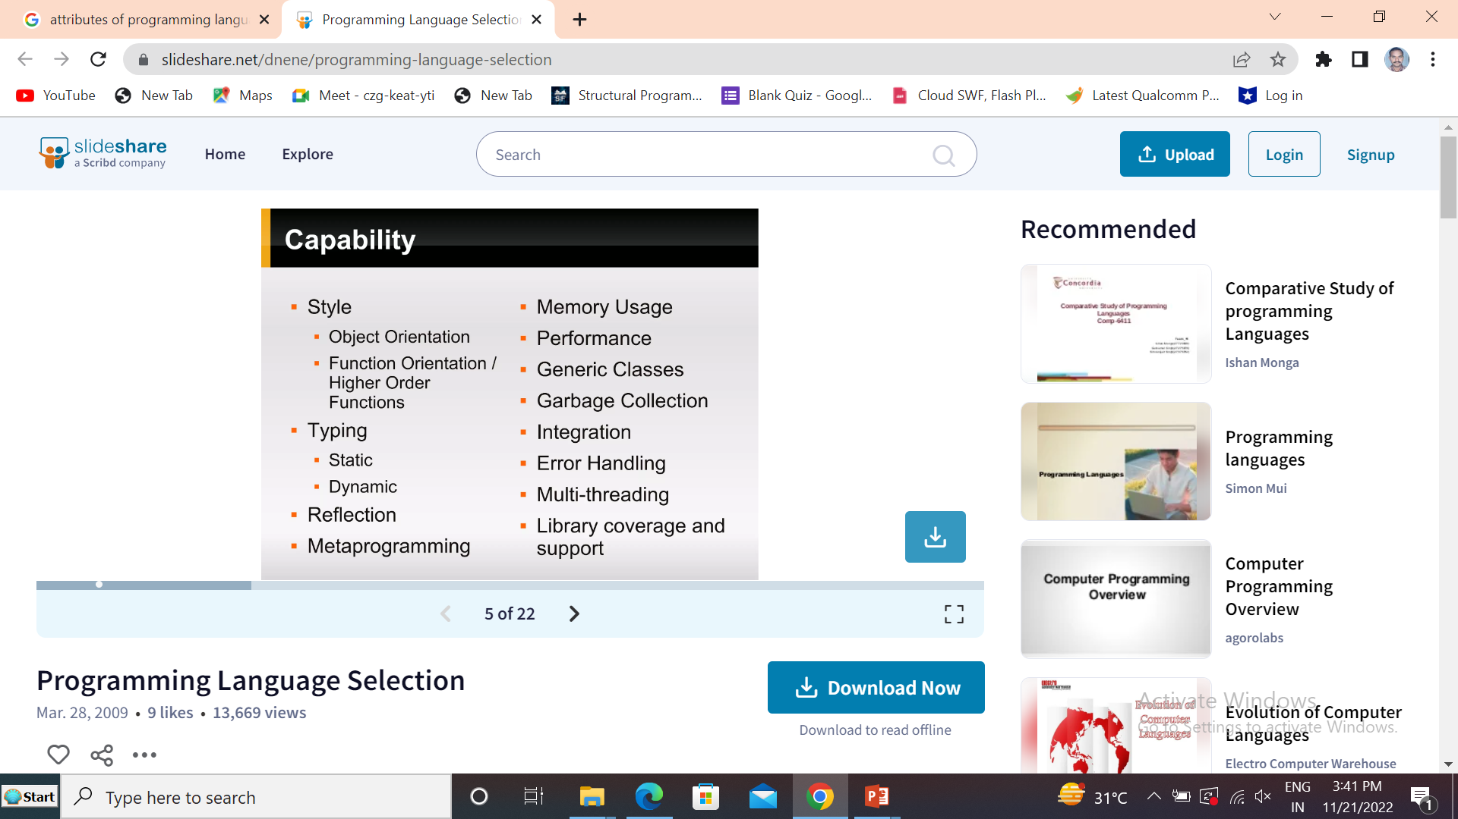

Slide 4
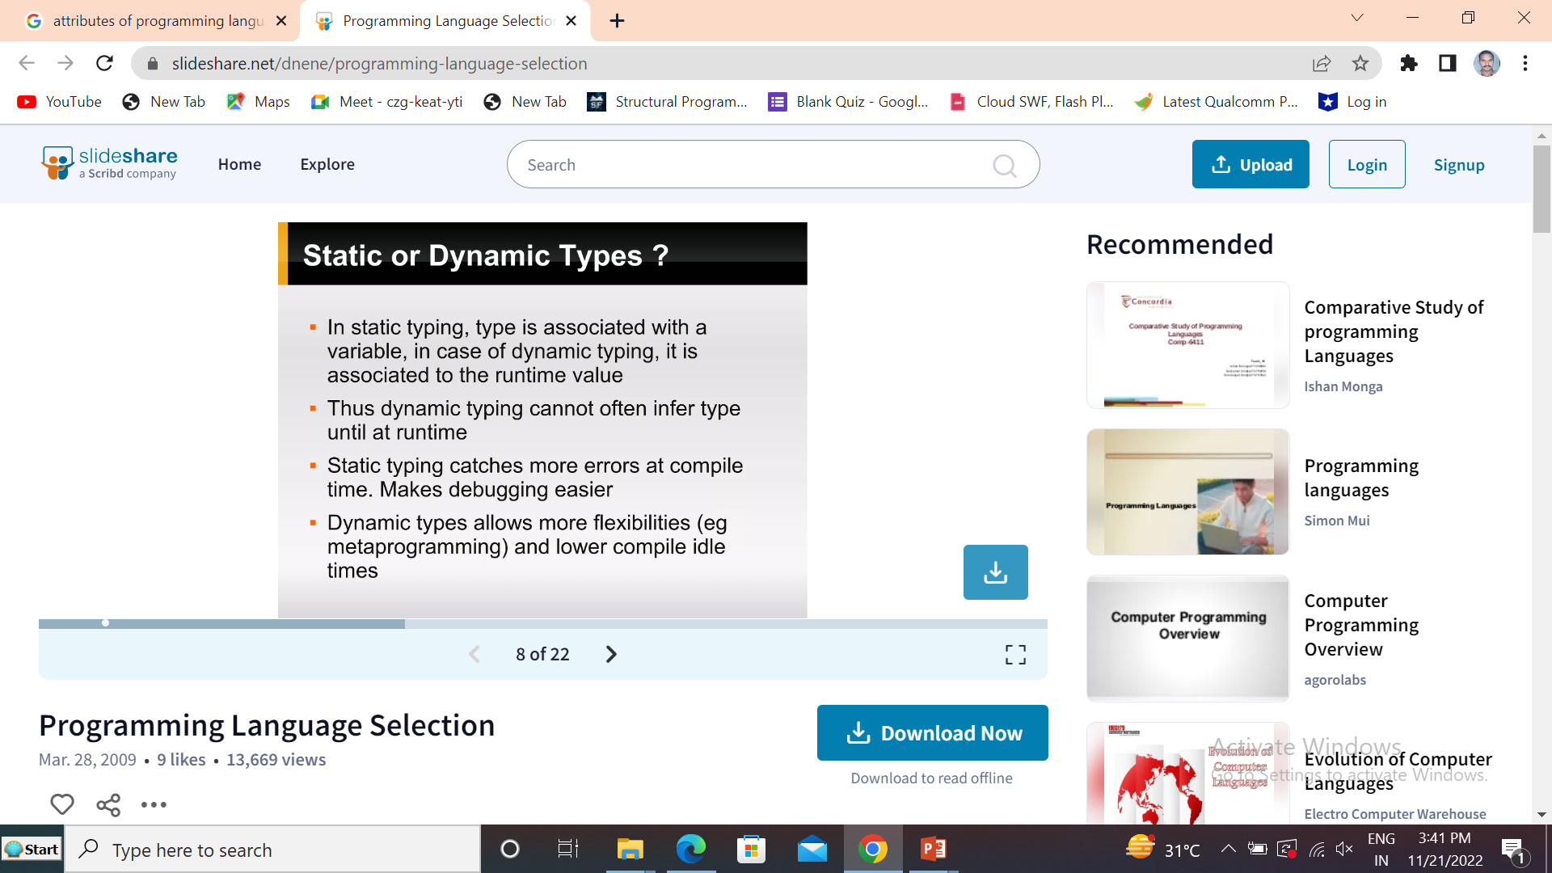

Slide 5


Slide 6
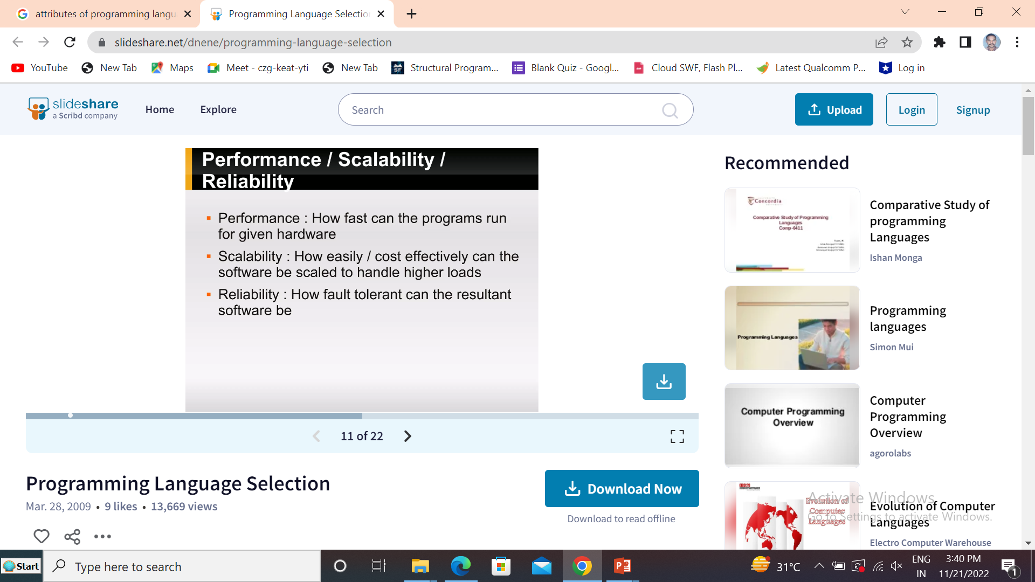

Slide 7


Slide 8


Slide 9


Slide 10


Slide 11
Why to Learn and Use C programming Language– C is a the Most Greenest Programming Language
Programming is one of the most important tools that have increased the power of computers and the internet. From small computational programs to big programs, a lot has been achieved by computer geeks with the help of programming.
Since it is very easy to learn, C programming in less time. Below are some of the compelling reasons to choose C programming online training.
1. Makes you familiar with the Programming Structures
As stated above, C is the base or foundation of the other programming languages, with learning the C programming; you would simultaneously learn the concepts of other programming languages. Same concepts like operators, data types, variables, and many more concepts are used in the same way we write in C.
2. Learn the Fundamentals of Computer Programs
Major programs like computer architecture, operating systems, computer networks, etc. are developed by C and require a decent understanding of C when you are working with them vice-versa. In today’s world, many more basic concepts are masked therefore in order to work with the basics of the computer system; you need to have C programming skills.
3. Easy to Learn and Apply
As the internet is flooded with a myriad of promotional content promoting the various programming languages, beginners like you often get confused to decide what they should learn first. You cannot master or develop great programming skills without mastering the base or foundation.
C is the foundation or base to understand the other high-level programming languages. Furthermore, it is very easy to learn even if you have zero knowledge of programming, you can learn it fast.
4. C is Omnipresent Languages
C is present everywhere. Major operating system’s Kernels are developed using C and even browsers like Chrome, Firefox use C in some manner. Furthermore, popular game engines, unreal engines, unity 3D, etc. are written in the C language.
Though it is an old language, it is still one of the most popular languages in the world. On the whole, if you want to learn the basics and fundamentals of computer systems and programming, having knowledge is a prerequisite.
5. Great career opportunities in coming future
Since C is used in almost every industry, job opportunities are plenty.

Slide 12
Energy Efficiency across Programming Languages- Greenest Languages
“This paper presents a study of the runtime, memory usage, and energy consumption of twenty-seven well-known software languages.
We monitor the performance of such languages using ten different programming problems, expressed in each of the languages.
Our results show interesting findings, such as slower/faster languages consuming less/more energy, and how memory usage influences energy consumption.
We show how to use our results to provide software engineers support to decide which language to use when energy efficiency is a concern.”
The Bench marks includes Energy, Time and Memory

Slide 13
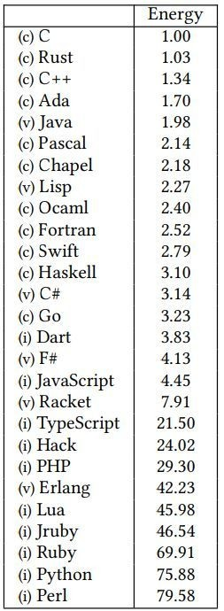
C is the most efficient programming language, while
Python and Perl are the least environmental friendly (Greenset) programming languages.

Slide 14
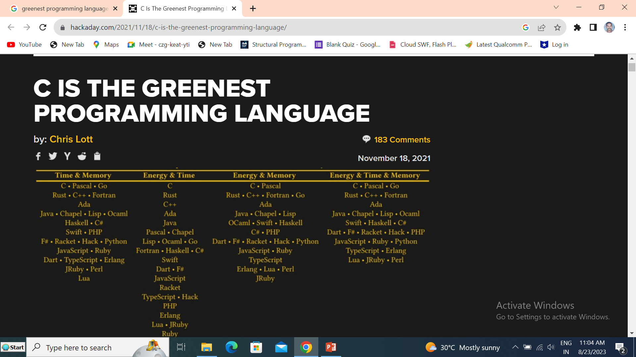

Slide 15


Slide 16
Programming Language Environment
IDE vs. SDK

Slide 17
Integrated Development Environment (IDE)
Net Beans and Eclipse are good example for IDE
An integrated development environment (IDE) is a software suite that consolidates basic tools required to write and test software.
Developers use numerous tools throughout software code creation, building and testing. Development tools often include text editors, code libraries, compilers and test platforms.
Without an IDE, a developer must select, deploy, integrate and manage all of these tools separately. An IDE brings many of those development-related tools together as a single framework, application or service.
The integrated toolset is designed to simplify software development and can identify and minimize coding mistakes and typos.
Some IDEs are open source, while others are commercial offerings.
An IDE can be a standalone application or it can be part of a larger package.
An IDE typically contains a code editor, a compiler or interpreter, and a debugger, accessed through a single graphical user interface (GUI).
The user writes and edits source code in the code editor.
The compiler translates the source code into a readable language that is executable for a computer. And the debugger tests the software to solve any issues or bugs.
Benefits of using IDEs
An IDE can improve the productivity of software developers thanks to fast setup and standardization across tools.
Without an IDE, developers spend time deciding what tools to use for various tasks, configuring the tools and learning how to use them. Many or even all of the necessary dev-test tools are included in one integrated development environment.
IDEs are also designed with all their tools under one user interface. An IDE can standardize the development process by organizing the necessary features for software development in the UI.

Slide 18
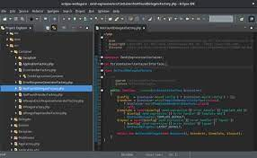
IDE – Sample Screen

Slide 19
What is SDK?
SDK is an abbreviation for a software development kit, often known as a devkit. It is a collection of software tools and programs that developers use to create apps for certain platforms.
SDK tools will contain libraries, documentation, code examples, procedures, and instructions for developers to utilize and incorporate into their own projects.
On the contrary, an Integrated Development Environment (IDE) helps programmers to streamline the process of creating a computer program.
IDEs boost programmer productivity by integrating typical software development tasks such as editing source code, generating executables, and debugging into a single applications
SDKs are software development kits that are intended to be utilized with certain platforms or programming languages.
They are a set of software tools and programs that developers can utilize to create various applications for certain platforms. SDKs have documentation that explains the working of each code with examples to make it more comprehendible.
To use an SDK successfully, a developer must have an iOS SDK to create iOS apps, an Android toolkit to create Android apps, a Nordic SDK to create Bluetooth or wireless apps, and a VMware SDK to integrate with the VMware platform.
A software development kit consists of application programming interfaces (APIs), documentation, libraries and processes, code samples, and guides that can be used and integrated into the developer’s apps.
An SDK uses an application programming interface to communicate with other software or applications.
It enables developers to make their applications more functional and helps make it faster and easier to design the standard components of their apps. SDKs can be used for simple features such as location services, logging in, mobile payments, etc.
There are certain software development kits that can assist developers in developing more advanced app features, like virtual reality, augmented reality, etc.

Slide 20
Comparison Table Between SDK and IDE
Parameters of Comparison | SDK | IDE
Full-Form | Software development kit | Integrated Development Environment
Uses | It adds functionality to applications and programs. | It is used to write and test codes.
Purpose | It provides programming tools. | It provides an interface.
Tools | It consists of documentation, processes, libraries, code samples, and guides. | Ide consists of auto-documentation, build automation, libraries debugger and translator.
Types | Platform SDKs, Extension SDKs, Structure SDKs | Cloud-based, Mobile applications, HTML, Apple or Microsoft development.

Slide 21
https://zerotomastery.io/blog/best-programming-languages-to-learn-in-2022/

